Slide 1
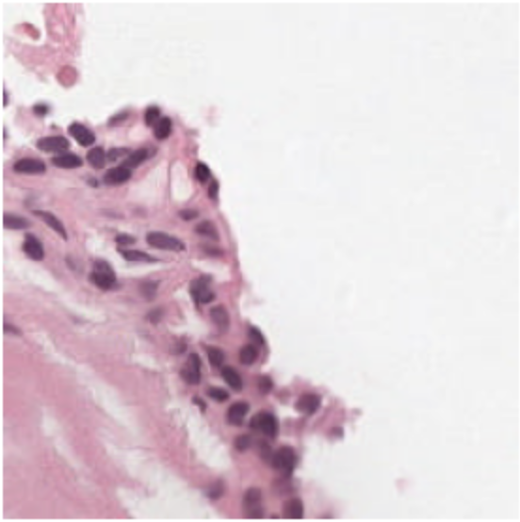
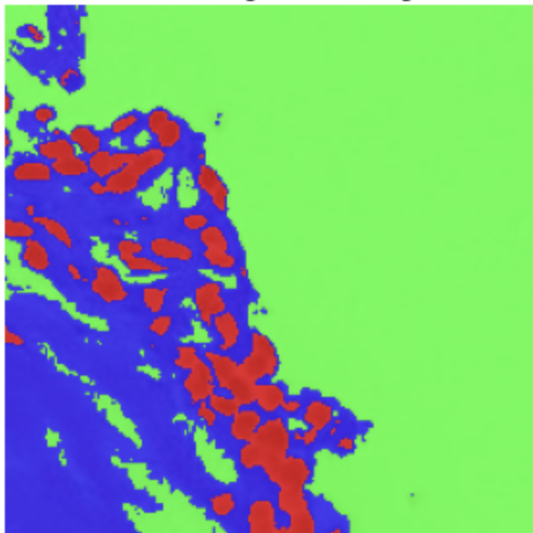
AI Campus Cedars
Team 6 Meeting (Tuesday, April 22): Semantic Segmentation of Prostate Cancer
Biopsy Tissue Using Deep Learning
PANDA (Prostate Cancer Grade Assessment) Challenge
Omar Lab
Department of Computational Biomedicine
Assistant Coaches: Okan Ozdemir and Rish Sharma
April 22, 2025
Semantic Segmentation

Slide 2
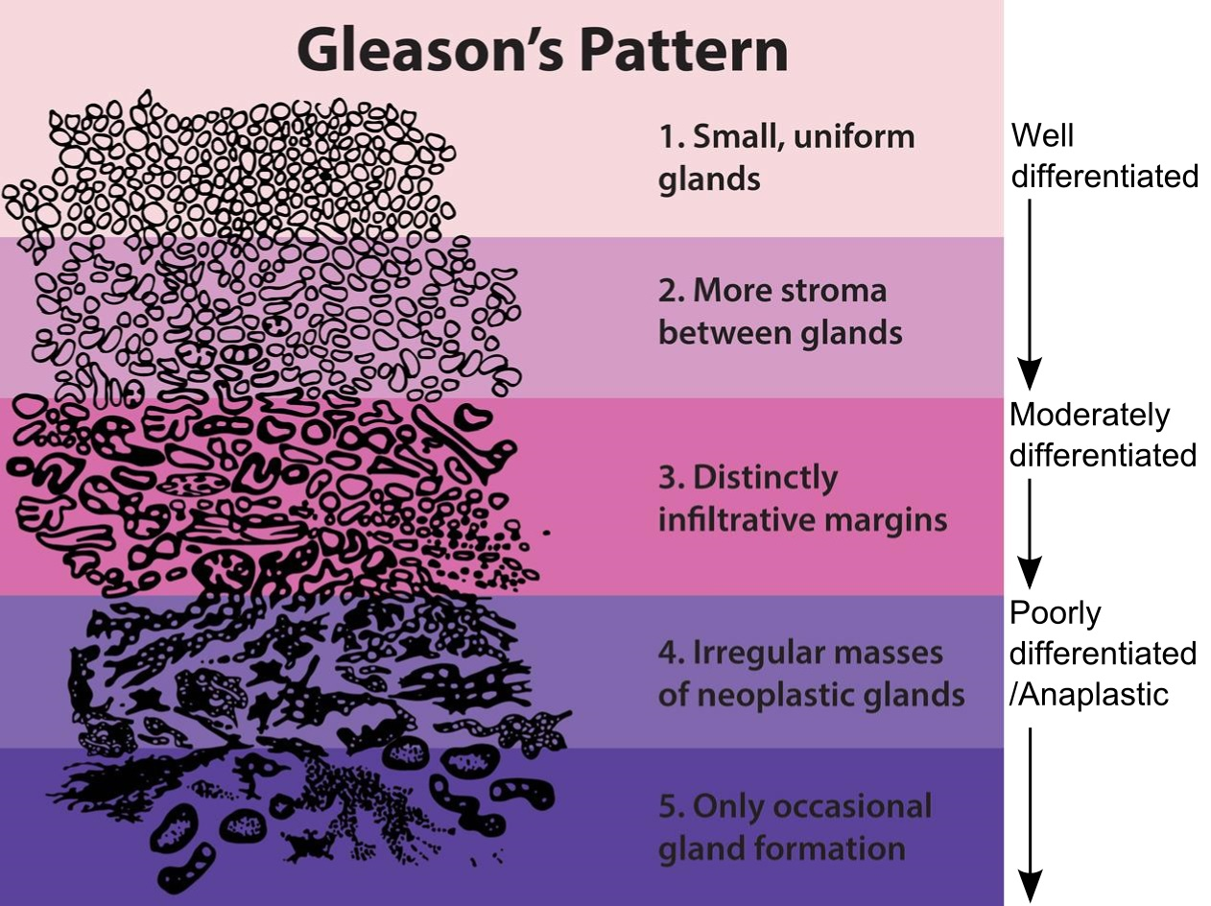
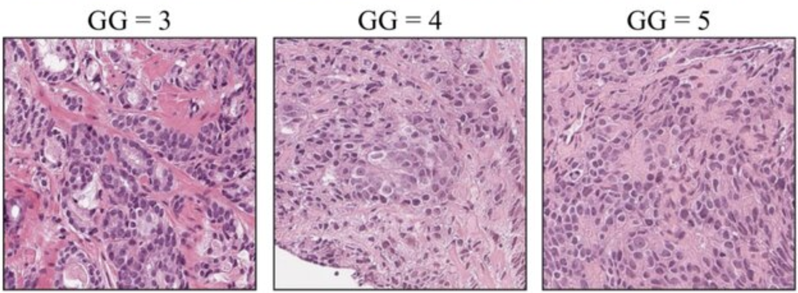
Prostate Cancer & Gleason Grading
The Gleason grading system is used to assess how aggressive the cancer is, based on glandular architecture seen in H&E-stained biopsy tissue. This grade influence treatment decisions: surveillance vs surgery/radiation.

Slide 3
Why Automate Tissue Segmentation?
Manual Gleason grading is time-consuming and subject to interobserver variability, especially between intermediate grades.
Automated segmentation into benign epithelium, stroma, and Gleason patterns will: a) standardize diagnosis, and b) enable large-scale analysis across thousands of cases

Slide 4
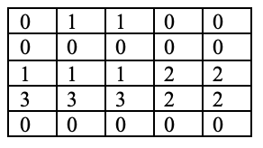
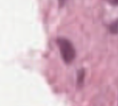
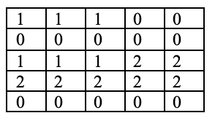
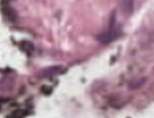
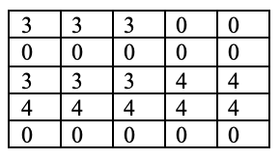
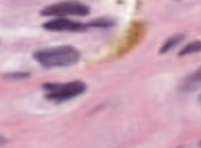
Dataset Overview (Image and Mask Pairs)
0: background (non-tissue) or unknown 1: stroma (connective tissue, non-epithelium tissue) 2: healthy (benign) epithelium 3: cancerous epithelium (Gleason 3) 4: cancerous epithelium (Gleason 4) 5: cancerous epithelium (Gleason 5)

Slide 5
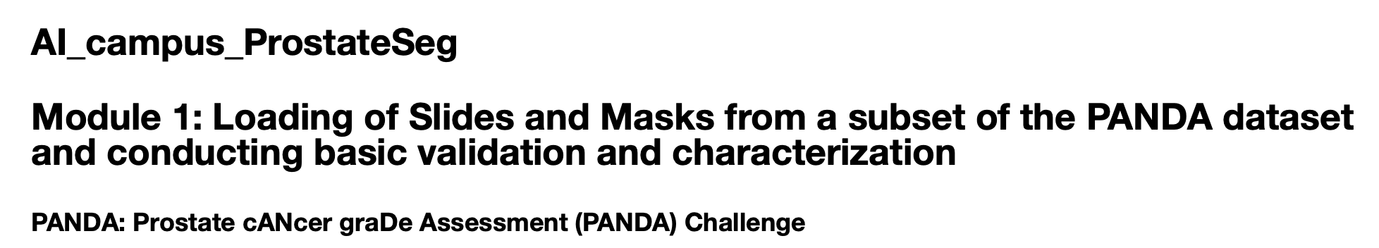
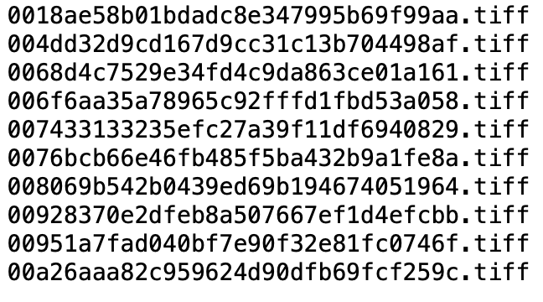
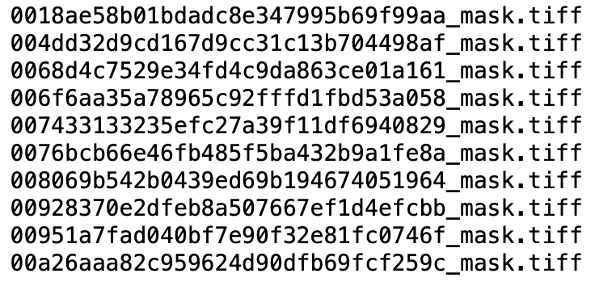
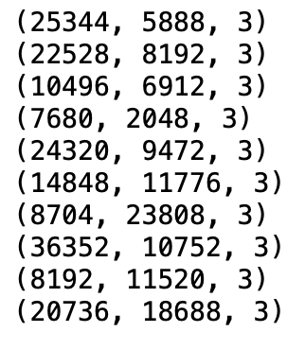
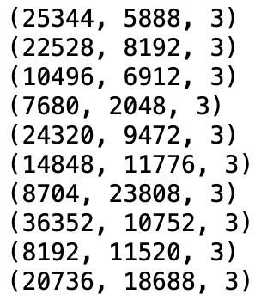
(Recap of Last Meetings) Module 1: Loading of Slide-Mask Pairs
Coupled image and mask files dataset
Matched dimensions

Slide 6
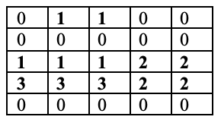

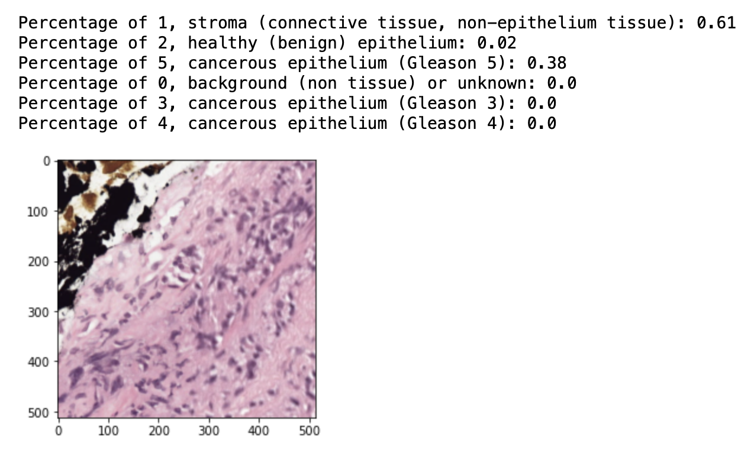
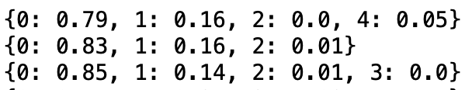
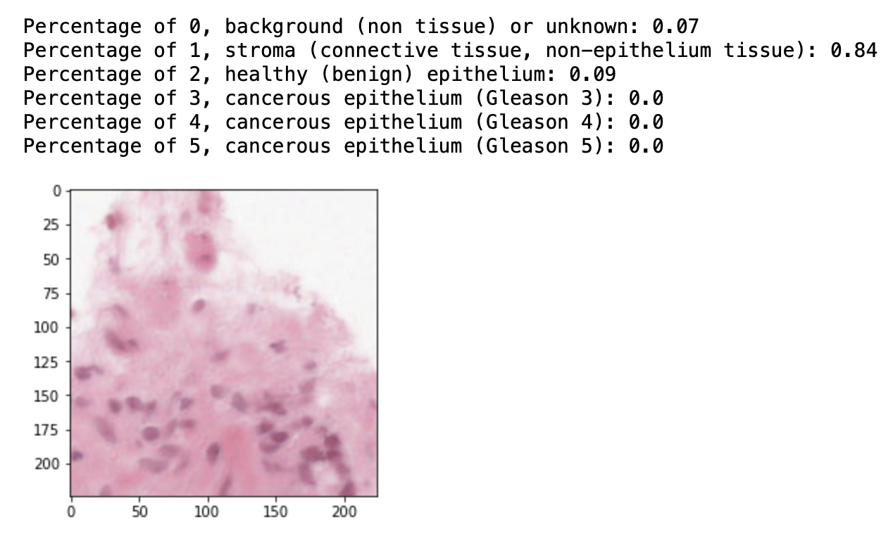
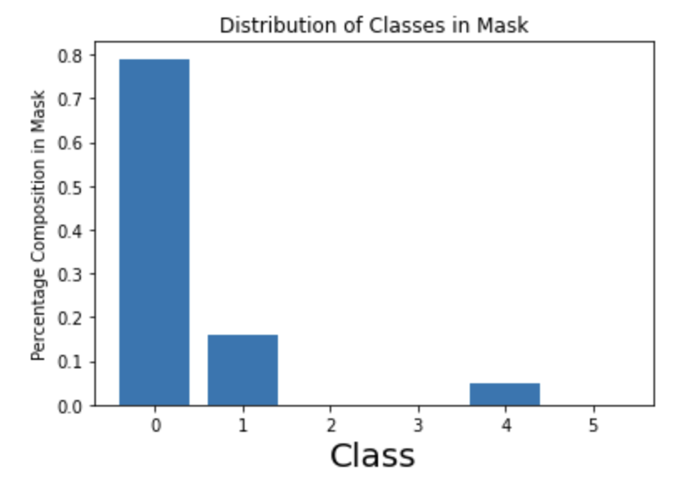
(Recap of Last Meetings) Module 2: Data Visualization and Exploratory Data Analysis
Summary of signal to background ratios in masks
Tile-wise plots by distribution of classes
Summary of class presence in masks
Summary of class distributions in masks

Slide 7
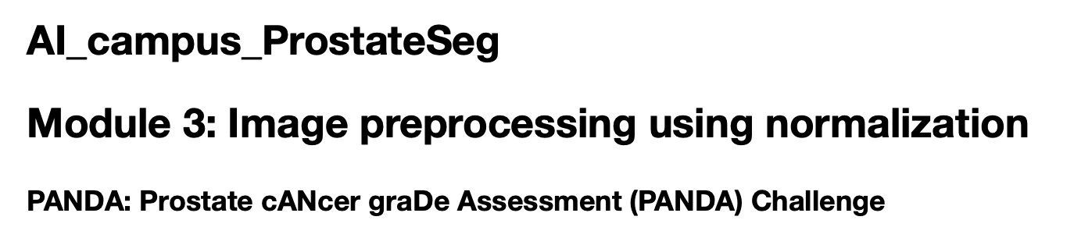
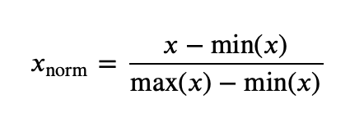
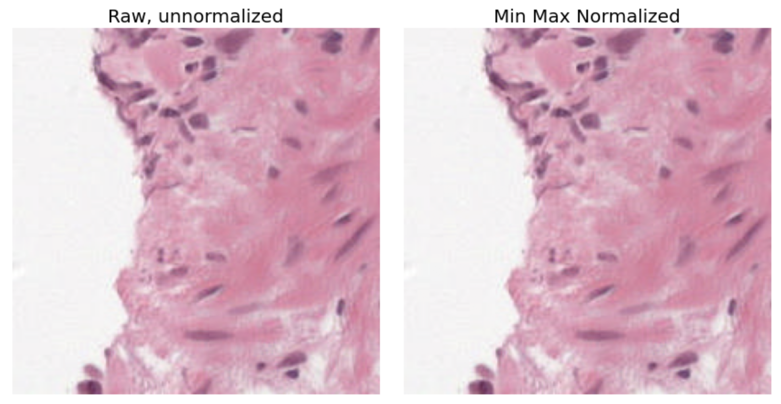
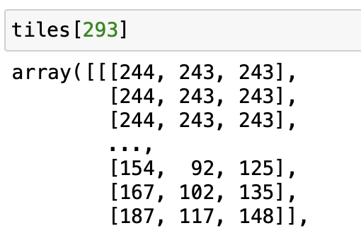
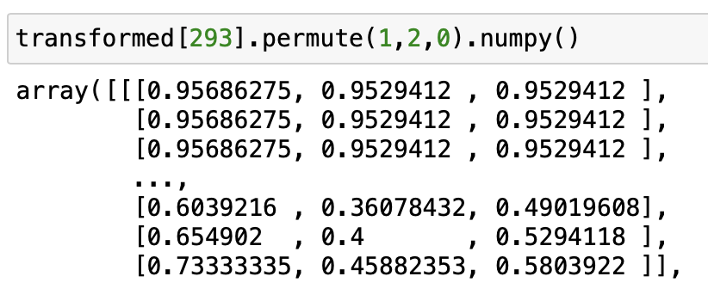
(Recap of Last Meetings) Module 3: Image Pre-Preprocessing Using Normalization
Min-max normalization
Channel-wise normalization

Slide 8
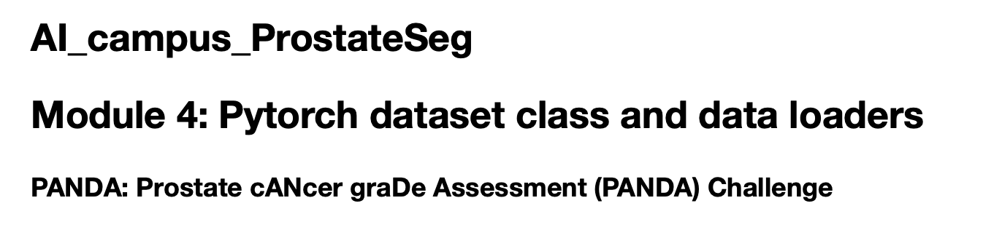
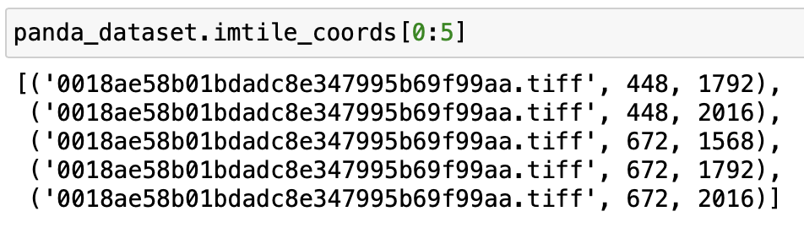
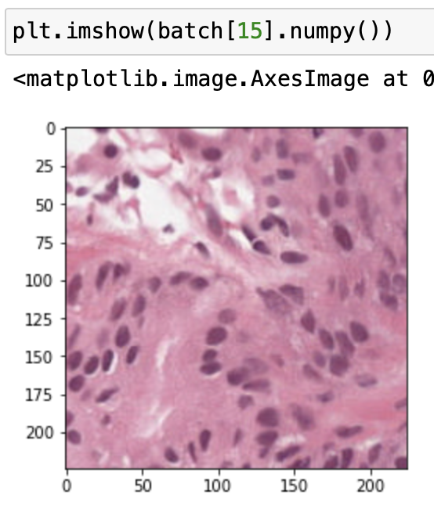
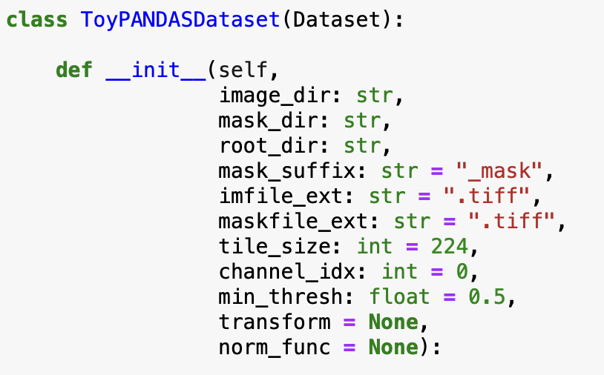
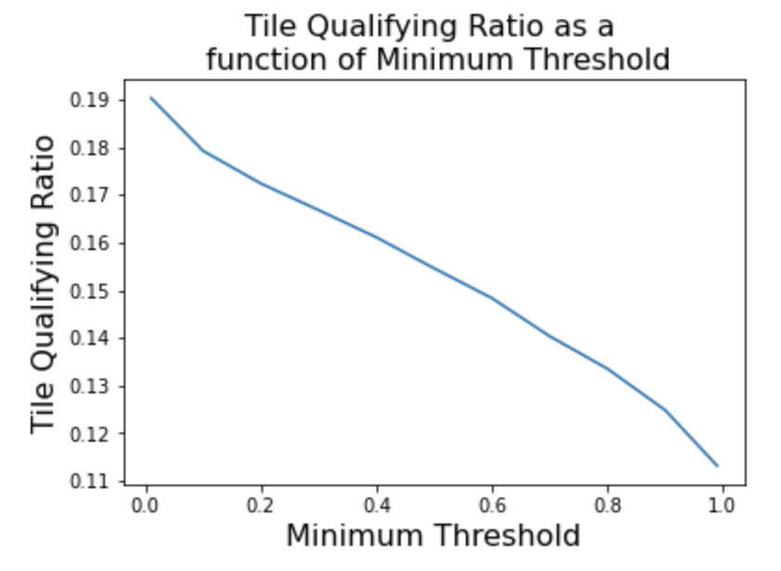
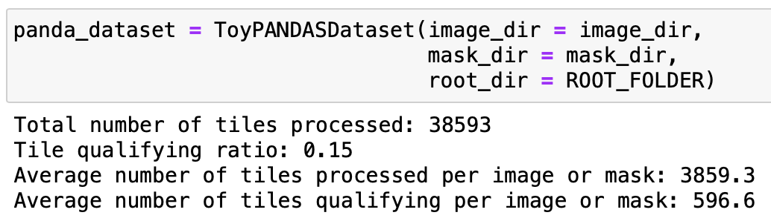
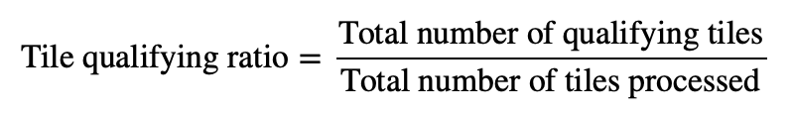
(Agenda for Today’s Meeting) Module 4: PyTorch Dataset Class and Data Loaders
Dataset class iterates over image tiles, tuple contains image file and tile coordinates
Example tile
Custom dataset class
Tile-wise processing of PANDA dataset images

Slide 9
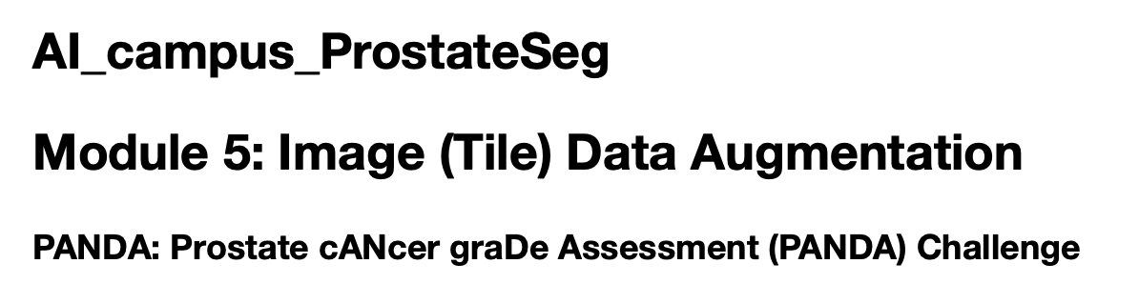
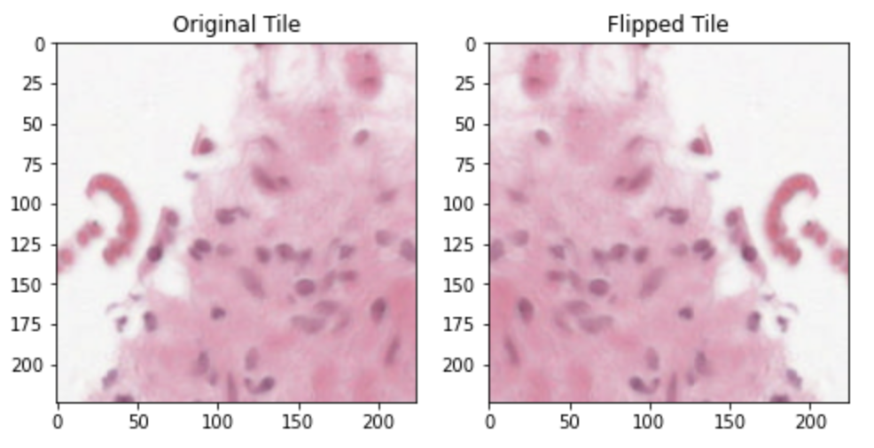
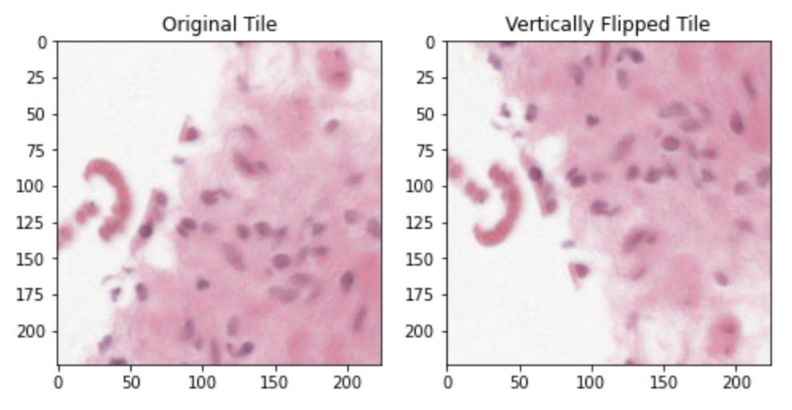
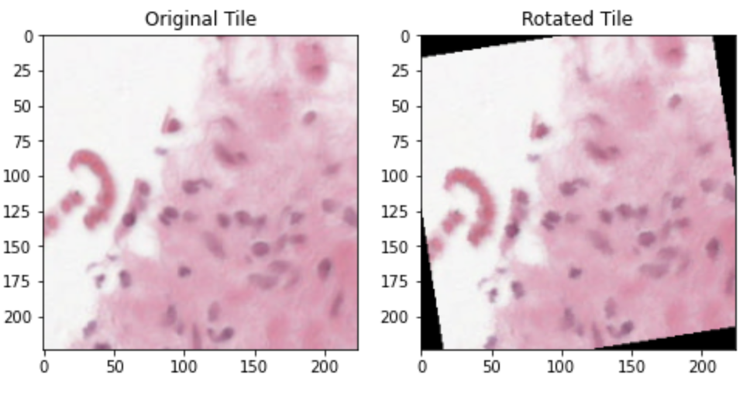
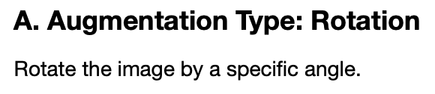
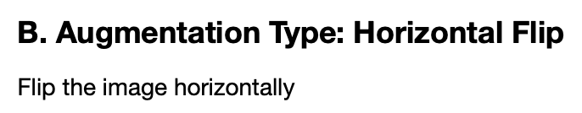
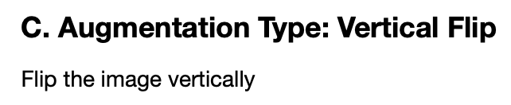
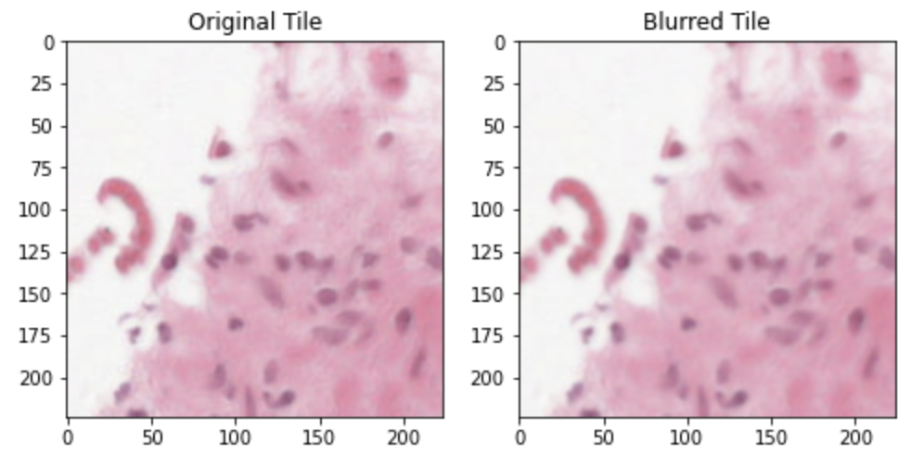
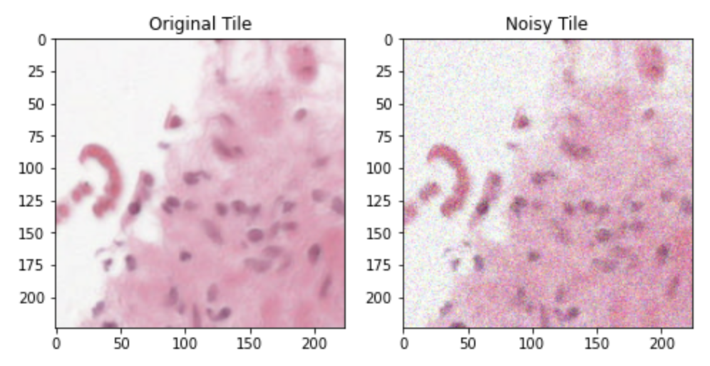
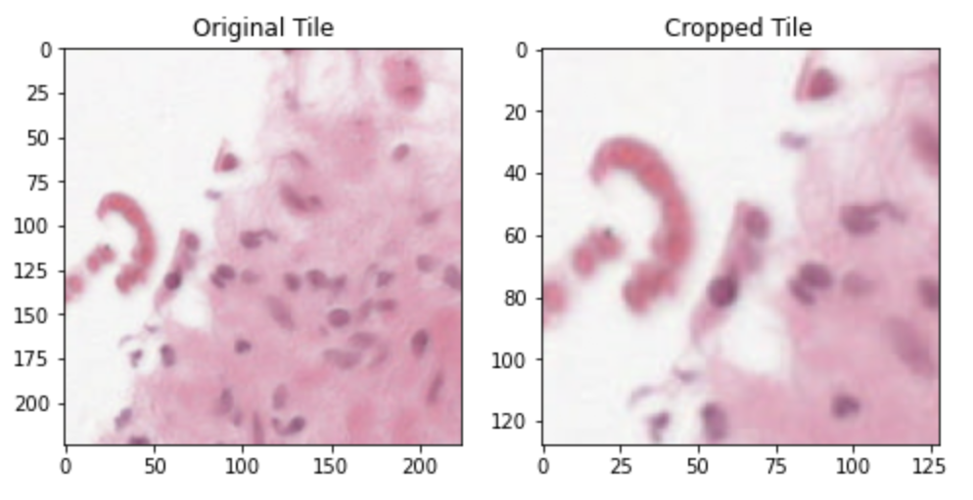
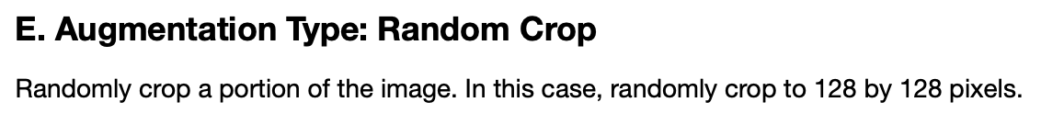
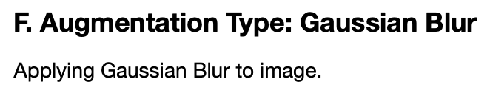
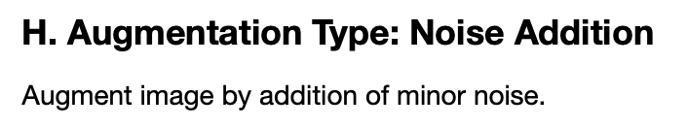
(Recap of Last Meetings) Module 5: Image (Tile) Data Augmentation

Slide 10
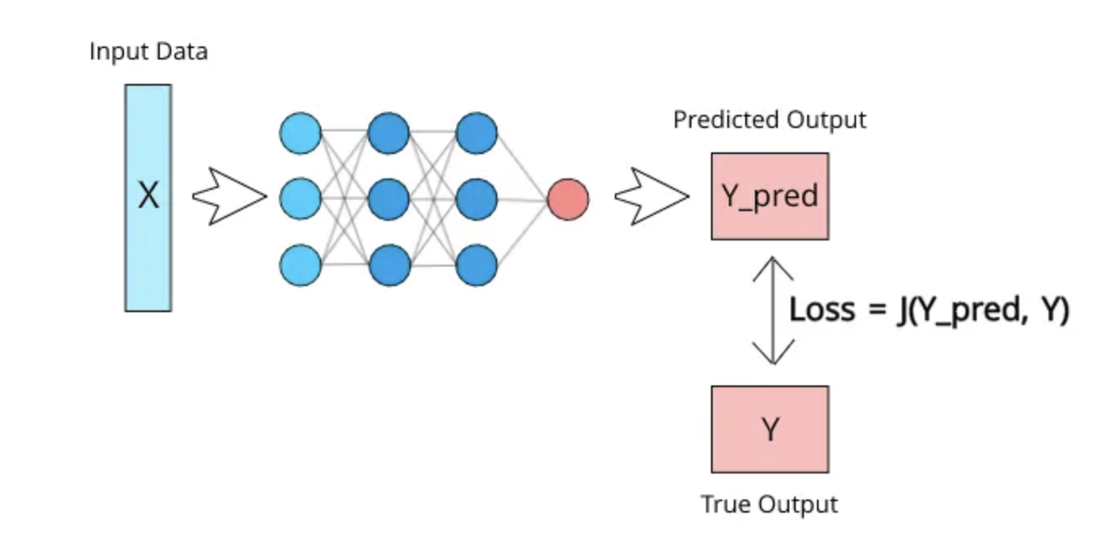
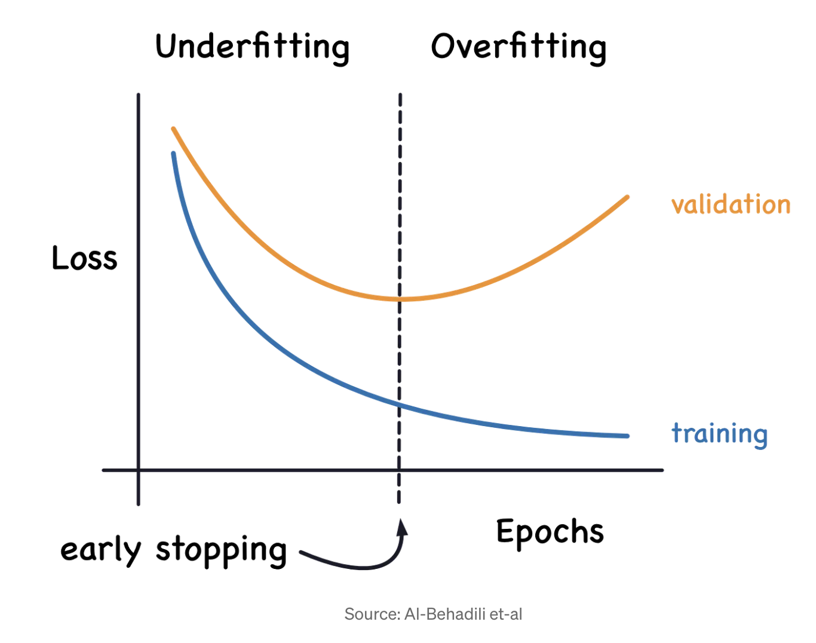
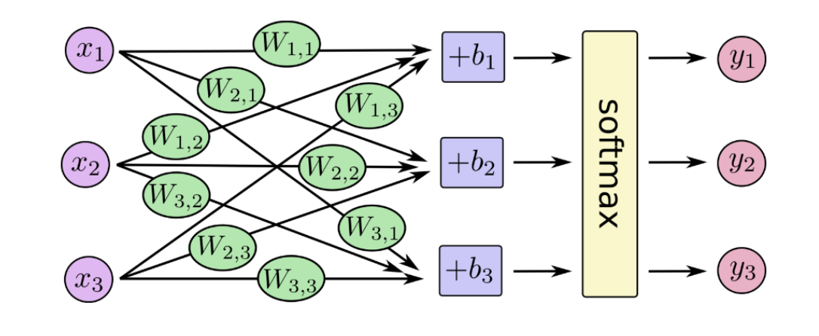
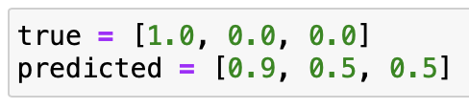
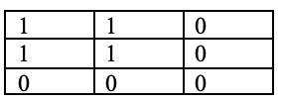









(Agenda for Today’s Meeting) Module 6: Loss Function and Metrics for Semantic Segmentation
Forward pass
www.medium.com
1 epoch = One complete pass of the entire training dataset through the neural network
Early stopping – Determine when to stop model training
Backward pass (model parameter update)
Intersection over Union (IOU) between ground truth and predicted mask pairs
Cross-entropy loss
IOU=1.0
Ground truth mask
Predicted mask
IOU=0.33
Ground truth mask
Predicted mask
IOU=0.00
Ground truth mask
Predicted mask

